Slide 1
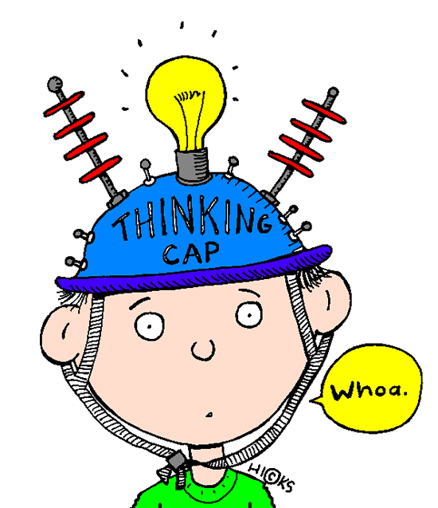
Forest Heights STEM Academy Gifted Programs
Annual Gifted and Talented Informational Meeting

Slide 2
Program Overview
Staff- School Level, District Level
Philosophy- The Little Rock School District is committed to providing quality, equitable educational programs for students with a potential for giftedness. The gifted programs are designed to challenge these students who have unique needs, abilities, and talents through a variety of learning approaches, including enrichment, qualitatively differentiated curriculum, and acceleration.
Definition- Gifted and Talented children and youth are those of high potential or ability, whose learning characteristics and educational needs require qualitatively differentiated educational experiences and/or services. Possession of these talents and gifts, or the potential for their development, will be evidenced through an interaction of above average intellectual ability, task commitment, and/or motivation and creative ability. -Arkansas Dept. of Education

Slide 3
Goals
Develop a systematic and continuous method of finding/identifying new students whose needs indicate a need for service and support, and who will benefit from participation in the program.
Develop, implement, manage, and support a variety of program options that meet the needs of advanced learners
Provide educational opportunities and differentiated experiences particularly suited to the needs of gifted learners through which they can continue developing and exceed their potential
Establish learning environments that value and enhance intelligence, talent, creativity, higher levels of thinking, problem solving, and affective growth
Provide opportunities for active participation and engagement of students, parents, families, staff, and community members
Create processes and procedures that support the schools’ efforts to meet and exceed standards.
Recognize and celebrate diversity; strive to identify top 10% in each ethnic group
Celebrate strengths and successes while addressing deficits
Practice the art of reflection in all aspects of the program for the purpose of improvement

Slide 4
Identification
Identification
-Nomination/Recommendation
Who can nominate?
Parent/Student/Teacher
Administrator/Self
-Standardized Exam Scores, Grades, Task Commitment, screeners, observation data-indicators of need for services.

Slide 5
Identification
Additional Data collection:
Non Verbal Reasoning Assessment
Achievement Exam Scores
Classroom Grades
Behavioral Rating Scales
Gifted Academic Exam Scores (Sages)
K-1 Enrichment samples and observation data
Student auditions/Interviews/Projects
Final Placement Decisions made by a Selection Committee of School Personnel

Slide 6
Joseph Renzulli Giftedness Definition
Logical Reasoning
Creativity
Task Commitment
Academic Ability

Slide 7
Identification
Selection committee reviews all data collected from talent pool for each grade level:
Achievement Test Scores
Creativity Test Scores
Behavioral Observation Ratings
Reasoning Exam Scores
Math/Science and Language/Social Studies Scores

Slide 8
Identification
Blind screening is conducted for all tested students….only scores are reviewed. Student names are not revealed.
The Selection committee determines if placement is needed and appropriate based upon review of data included on student profile.

Slide 9
Characteristics of Giftedness…
Learning Examples
-Advanced vocabulary
-Quick mastery and recollection of facts.
-Enjoys reading
-Wants to know what makes things tick.
-Catches or understands more than others when reading or viewing a film, movie, etc.

Slide 10
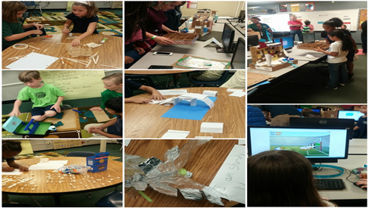
Gifted Characteristics
Motivational Examples
-Easily bored with routine tasks.
-Becomes absorbed in topics of interest.
-Strives for perfection.
-Works independently
-Stubborn! Are sure of what they like, want, and need.

Slide 11
Gifted Characteristics
Creativity Examples
-Constantly asks questions.
-Gives unique and clever responses.
-Is comfortable taking risks.
-Loves adventure.
-Has a keen sense of humor.
-May be emotionally sensitive.
-Likes to adapt, improve, or modify things.

Slide 12
Gifted Characteristics
Motivation Examples
-Carries responsibility well.
-Is self confident.
-Adapts well to new situations.
-Is sociable.
-Directs classroom when placed in a group activity.
-Expresses him/herself well.

Slide 14
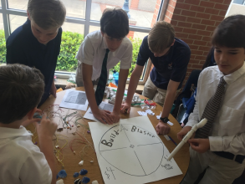
Program Options
Grades K-1: Whole Group Enrichment/Small Group Sessions
Grades 2-5: Pull-out Classes taught by G/T certified staff. Students receive 150 minutes of support/ service per week.
Grades 6-8: GT Subject classes, GT Seminar, and/or Pre-Advanced Placement Coursework. Teachers at the middle school level are certified to offer these options.
Grades 9-12: Upper level courses according to interest and ability- Pre-Advanced Placement (Pre-AP), Advanced Placement (AP), seminars, mentorships, concurrent credit, independent studies. All teachers are trained to provide the program options for which they teach.

Slide 15
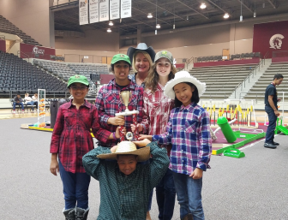
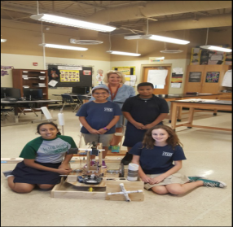
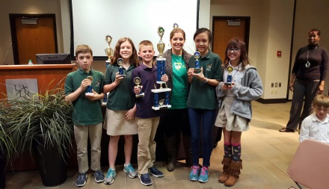
Additional Program Opportunities
Quiz Bowl
Chess
Duke Talent Identification Program (Grade 7)
Governor’s School
Destination Imagination
Mathletes (District Math Dept.)
Science and Math Fairs (Various Schools)
Y.E.S. (Youth Entrepreneur Showcase)
Stock Market Game
Arkansas School for Math, Science, and the Arts (may apply)
Others as they occur

Slide 16
Curriculum
Curriculum for the gifted must differ not only in degree, but in kind. It is important to avoid ‘more of the same.’ It should be coordinated with the district’s basic curriculum objectives but MUST BE IN PLACE OF, RATHER THAN IN ADDITION TO required classroom work. Students should not be penalized for being identified as gifted by being given extra work. Teachers should be sensitive to student interests and talents in planning both cognitive and affective activities. (Page 26 of the ADE GT Rules and Regulations)
Curriculum should be differentiated in the areas of content, process, and/or product. Differentiation may be in level of complexity, pace of learning, or degree of abstractness. Another means of differentiating may be by studying topics not ordinarily taught as a part of the regular curriculum. Process skills for GT students should include: critical thinking, creative thinking, independent learning skills, research skills, problem-solving, and logic. Development of a scope and sequence ensures continuity of curriculum objectives.

Slide 17
Curriculum
Additional skills targeted by G/T program:
Decision making
Problem solving
Creative Thinking
Independent Study
Research and Organization.
Affective, interpersonal and character development.

Slide 18
Bloom’s Taxonomy (Regular Classroom)
Evaluation
Synthesis
Anyalysis
Application
Comprehension
Knowledge

Slide 19
Bloom’s Taxonomy (Gifted Classroom)
Knowledge
Comprehension
Application
Analysis
Synthesis
Evaluation

Slide 20
Everything G/T
Other support sources:
National Association for Gifted Children- NAGC- www.nagc.org
Arkansans for Gifted and Talented Education- www.agate-arkansas.org
Visit the LRSD Gifted Programs website at www.lrsd.org
Like us on Facebook- LRSD Gifted Programs@giftedlrsd.
Follow us on Twitter- LRSD Gifted Programs@Giftedlrsd

Slide 21
Thank you for sharing your child with us!!!
If you have questions, suggestions, or concerns about G/T please contact us:
Specialist Information****
LRSD Gifted Programs Office
Romona Cheneval- Director
501-447-3392
Jennifer Thomas- Secondary/AAIMS Coordinator
501-447-3393

Slide 22
